Slide 1
FHSAA
Finance, Eligibility & Compliance Update
FIAAA – May 6th, 2018

Slide 2
FHSAA
Linda D. Robertson
Associate Executive Director Business Services Florida High School Athletic Association Gainesville, Florida

Slide 3
FHSAA
Craig Damon
Associate Executive Director Eligibility and Compliance Services Florida High School Athletic Association Gainesville, Florida

Slide 4
FHSAA
Jordanne Stark
Director of Eligibility and Compliance Florida High School Athletic Association Gainesville, Florida

Slide 5
FHSAA
Finance Update
Major Changes to Streamline, Simplify and Automate Financial Forms and Fees
Sanctioning of Events & Sanction Fees
Hosting State Series Playoffs & Financial Reporting
Ordering State Series Passes

Slide 6
FHSAA
Finance Update - Sanctioning
Preseason - Classics, Jamborees or Tournaments
Baseball, Basketball, Soccer, Softball, Girls Volleyball, Wrestling, Cross Country, Swimming, Track, Boys Weightlifting, Football
Post season - Bowls (Football)
Spring Classics - (Football)
No Sanctioning required for: Regular Season, or Sports not listed on this slide!

Slide 7
FHSAA
Finance Update - Sanctioning
Hosting National TV Events –
Not required to sanction if regular season (no fee)
Sanction Pre/Post season event in one of the listed sports –
Flat $2,000 fee (currently 25% of gate) if national TV

Slide 8
FHSAA
Finance Update - Sanctioning
NEW –
Sanction Approval (AT2/AT3) and Football Classic/Jamboree or Bowl Financial (FB3/FB4) on Home Campus
Attend Technology session for a live demo!
Calculations done for you!
Invoicing immediately and available on your HC home page
Forms generated when you schedule a game OR you can select from the “Forms” menu and it will place event on your schedule

Slide 9
FHSAA
Finance Update - Sanctioning
Sanction Fees – New for 2018-19
No longer required to sanction 30 days prior – must be ONE day prior (or pay $50 higher fee)
Eliminated $100/$200 fines for failure to sanction prior to event
Fees based on lowest current rates, regardless of number of teams (big savings for large tournaments!)
Pay $50, $75 or $100 depending on sport not on # of teams
Must still pay fee within 30 days of event – fines remain intact for late pay

Slide 10
FHSAA
Finance Update - Sanctioning
Sanction Fees – New for 2018-19
FB Jamborees will be charged lower of 20% of gate or flat fee based on classification -same as Classics
FB3 Bowls & FB4 Classics financial report – combined, simplified and submitted on Home Campus – eliminated reporting of event expenses
Classics & Jamborees – net profit shares - defaults to 65/35 Host/Visitor unless specified in contract

Slide 11
FHSAA
Finance Update – State Series Hosting
8 sports require shares of revenue to FHSAA (no changes)
Football
Baseball
Boys & Girls Basketball
Boys & Girls Soccer
Softball
Girls Volleyball

Slide 12
FHSAA
Finance Update – State Series Hosting
New for 2018-19
FN2 (non-football sports) and FB 5 (football) financial reports, will be submitted through Home Campus
Calculations done for you!
Form will be placed on your home campus page when you are assigned to host
Schools able to view their reports that are due

Slide 13
FHSAA
Finance Update – State Series Hosting
Host Expense Reporting
Swimming pool rental maximum raised to $2,500
Rental expenses for portable bleachers or stadiums not allowed to be reported IF expanding capacity beyond minimum required
Home Campus FN2 form will place limits on some fields (i.e. event manager and trophies) and may request proof of expenses that appear out of the norm

Slide 14
FHSAA
Finance Update – State Series Hosting
New for 2018-19 –Ticketing and Passes
Electronic ticketing though FHSAA vendor (Huddle/GoFan) required when requested by FHSAA
State Pass Log AT10 – no longer required to be used or submitted – optional use by the host

Slide 15
FHSAA
Finance Update – State Series Hosting
By-Law 8.7.2 – failure to comply with reporting and payment policies “will result in restrictive probation for all sports until proper remuneration is made.”
New Policy - Schools may be sanctioned including loss of ability to host State Series events if falsify or fail to follow reporting deadlines and requirements

Slide 16
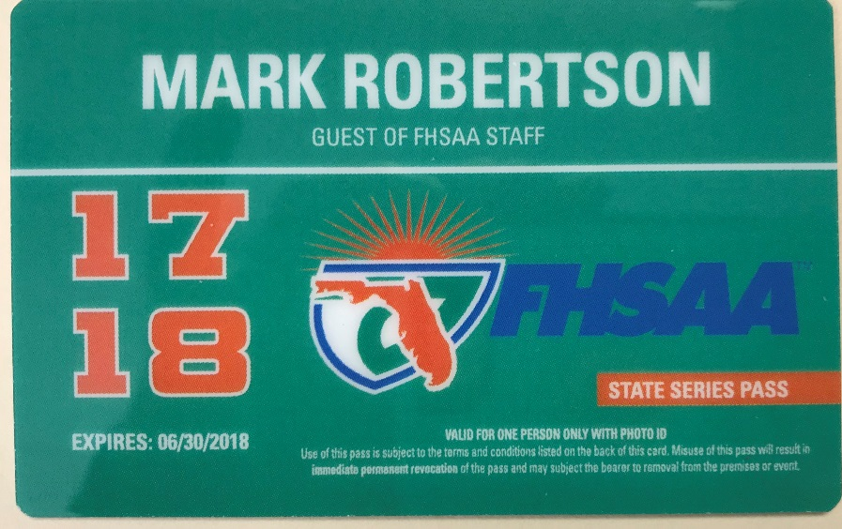
FHSAA
Finance Update – State Series Pass
Orders will be placed on Home Campus
Scheduled to be available for ordering by September
Immediate invoice posted on your Home Campus page
Hear more in Home Campus session today!

Slide 17
FHSAA
Finance Update – Summary
AT2
FB3
FN2
Required: AT2 (Sanctioned event); FB3 (FB Classic/Jamboree/Bowl Financial); FN2 (State Series Host Financial)
Eliminated forms:
AT2S (supplemental to AT2 sanction) – on new AT2
AT3 (FB sanction) – on new AT2
AT3S (supplemental to AT3) – on new AT2
FB4 (FB Classics Financials) – on new FB3
FB5 (FB State Series Financials) – on new FN2
FNTV (Sanction for National TV) – on new AT2
AT10 (State Pass Log) – available only for optional use

Slide 18
FHSAA
Finance Update – Summary
One fee (non-FB sports) – not based on # of teams
Jamborees & Classics treated the same
No longer report expenses on FB Classics/Bowls
Calculations will be done for you after minimal entry of basic information (# tickets sold, price per ticket)
Invoicing immediate
Ability to see reports due on your Home Campus page

Slide 19
FHSAA
Eligibility and Compliance Update
Significant Changes that Impact Student Eligibility
Non-Traditional Student Requirements
Transfers
Due Process

Slide 20
FHSAA
E & C Update – Non-Traditional Students
NEW 2018-19: Register Intent
Register intent before participation
Submitting FHSAA Eligibility Forms such as:
EL2, EL3, EL12, EL13, or EL14 (depending on type of student)
Reflect State Statute – HB 731 and HB7055
Consistent with Traditional Student Participation

Slide 21
FHSAA
E & C Update – Non-Traditional Students
NEW 2018-19: Register Intent
Impacts Bylaw 9.2.2
Home Education - 9.2.2.1.1(b)
Charter School – 9.2.2.2.1(e)
Alternative/Special School – 9.2.2.3.1(b)
Non-member Private – 9.2.2.4.1(e)
FLVS Full Time – 9.2.2.5.1(e)
Policy 16.2

Slide 22
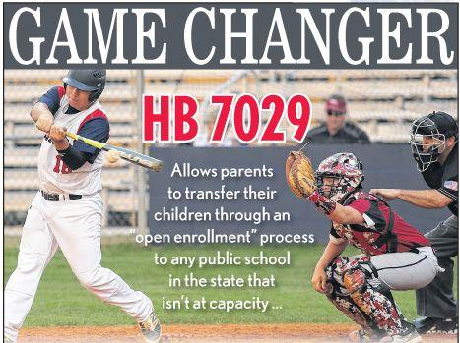
FHSAA
E & C Update – Transfers
NEW 2018-19:
Bylaw 9.3.2
Transfer After Starting a Sport
Active Military Order Change…
Foster Care Placement Change…
Court-ordered Change in Custody…
Authorized for “Good Cause in District or School Board Policy
Please Update Your “Good Cause Policy”

Slide 23
FHSAA
E & C Update – Transfers
HELPFUL TIPS:
Communicate With Previous School
Athletically Eligible?
Issues or Concerns?
Sports Participated?
GA4 – Affidavit of Compliance with FHSAA Recruiting Policy
Current EL2, EL3
Official Transcript With All Grades

Slide 24
FHSAA
E & C Update – Due Process
Sectional Appeal Committees
Ability to modify decisions

Slide 25
FHSAA
Preventing Fines - Conduct
70% of all fines are Unsportsmanlike Conduct
248 conduct fines issued this year
145 were COACHES behavior
103 were STUDENT behavior
Cost to schools $64,800
Most severe single incident fines for poor conduct:
$3,250 Football bench brawl
$2,900 Coach profanity
$800 FB player

Slide 26
FHSAA
Unsportsmanlike Fines – by Sport
Coaches – 34 Boys Basketball; 28 Baseball; 25 Boys Soccer; 12 Softball; 11 Girls Basketball; 11 Girls Soccer; 9 Football; 5 Wrestling; 2 Girls Volleyball; 1 Water Polo
Students – 36 Boys Soccer; 10 Football; 9 Boys Basketball; 7 Boys Lacrosse; 6 Baseball; 5 Girls Soccer; 4 Girls Basketball; 4 Girls Lacrosse; 4 Wrestling; 1 Boys Volleyball; 1 Water Polo

Slide 27
FHSAA
Preventing Fines - Eligibility
10% of all fines are Eligibility Violations –
36 eligibility fines issued
Cost to schools $44,500 (highest average cost per fine)
Most severe single fines for eligibility:
$15,000 – Playing ineligible students multiple games - football
$4,200 – Playing ineligible student multiple games - baseball
$4,100 – Playing ineligible student multiple games – girls basketball

Slide 28
FHSAA
Preventing Fines – Policy Violations
10% of all fines are Eligibility Violations –
36 eligibility fines issued
Cost to schools $31,397
Most severe single fines for eligibility:
$14,000 - Open facility basketball – 2nd offense
$2,447 – Impermissible benefit - baseball
$1,600 – Girls Lacrosse – multiple issues

Slide 29
FHSAA
Preventing Fines –
Most Severe Fine of the year
$70,000 – Cross Country - multiple violations of improper contact, recruiting and eligibility violations at one school with lack of institutional control, failure to self-report

Slide 30
FHSAA
Non-Financial Sanctions –
FB – Spring Practice & Classic
Baseball – 15 Days of Practice 2019 Season
Multiple Sports – Moved up a Classification
Multiple Sports – Reduction of Maximum Contests

Slide 31
FHSAA
Preventing Fines –
Rosters
Entering Rosters on Home Campus Before Participation

Slide 32
FHSAA
E & C Update – Summary
Non-traditional register intent before participation
Communicate on transfers; “Good Cause Policy”
Ability to modify at the Sectional Appeals Committee
ROSTERS – SEL’s no longer required

Slide 33
FHSAA
Thank you

