Slide 1
Coaches Education
Coaches Education Program
FIAAA – May 5th, 2018

Slide 2
Coaches Education
Dr. Donny Peek
Assistant Principal/Director of Athletics Bloomingdale High School Valrico, Florida

Slide 3
Coaches Education
Why the Need
7.6 million student-athletes participate in interscholastic athletics
Coaches play significant role as mentor, leader, motivator
Coaches promote physical, mental, and emotional development of student-athletes
We need to prepare our coaches for success in all roles

Slide 4
Coaches Education
Current Issues
Minimal research on coaching educational needs
No set national standards for coach education programs
Different requirements from county to county / school to school
Lack of requirements by state associations
No mandatory rules clinic in Florida
Coaches learn differently
We expect our coaches to train our students but who is training our coaches

Slide 5
Coaches Education
Problems we face as ADs
Lack of qualified applicants
Temporary Certificate = 3 years of coaching (no ongoing education)
Teaching Certificate = coach
Revolving door of coaches

Slide 6
Coaches Education
What is the Significance
National education associations and national sport associations recognize the potential impact of coaches’ influence on athletes and have expressed concerns for the need to explore coach developmental programs
School districts nation-wide have begun to implement continuing education opportunities for its athletic coaches
no consistency on the requirements need to coach or even how material is presented.
As ADs we should understand the recommended design, delivery, and necessary components of a coach ed. program

Slide 7
Coaches Education
Lack of meaningful PD
Current PD from local and state
Opportunities are uniformed (all coaches don’t learn the same)
Not sport specific
Lacks correlation of theory into practice

Slide 8
Coaches Education
Coaches Education Program
UNDERSTANDING OUR COACHES NEEDS

Slide 9
Coaches Education
Role of Athletic Coach
LEADER
COMMUNICATOR
Parents
Admin
Officials
Athletes
MANAGER
EDUCATOR
EXPERT IN SPORT
MOTIVATOR

Slide 10
Coaches Education
Types of Knowledge
Subject Matter-Knowledge:
Coaching Methodology:
Sport Specific
Creating meaningful practices, trainings, & competitive schedule
Pedagogical Content Knowledge:
Ability to teach specific sport
Management content:
Leading with other coaches, paperwork, budgeting, making travel arrangements, field set-up
Curriculum Based Knowledge:
Awareness of available resources and practices

Slide 11
How do Coaches Learn
Coaches Education
Formal Education
Informal Education
Classroom setting
Concluded w/ a test
Cons:
Integrating theory into practice
Past playing experiences
Day-to-day experiences
Social settings
Mentors/other coaches
Cons:
Past experiences out dated

Slide 12
Coaches Education
Changes need to be made to current education program
Current curriculum is not fully preparing coaches to meet the demands of coaching
Needed shift from formal education to sport specific
Needed focus on managerial strategies that include:
Fundraising
Effective communication techniques
Completing paperwork

Slide 13
Coaches Education
Coaches Education Program

Slide 14
Coaches Education
Formal/Informal
Coach Education
Sport specific groups
Mentorship

Slide 15
Coaches Education
Creating a Coaches Education Program
INSIDE THE BUILDING
Promote opportunities for your coaches to attend sport specific clinics
National clinics / FACA
Cover cost / provide in-service
Have a successful coach in the building mentor a new coach
Help with paperwork
Fundraising ideas
Communication
Monthly Meetings (personal/email)
Rule changes
State/County Policies

Slide 16
Coaches Education
Creating a Coaches Education Program
OUTSIDE THE BUILDING
Establish Communities of Practice with in the District (sport specific)
District Level – Sport specific helps bridge gap with officials association
Ongoing education for temporary coaches
District - make it convenient
FHSAA must get involved
Bring back rules clinic
Meaningful trainings (concussion, cardiac arrest)

Slide 17
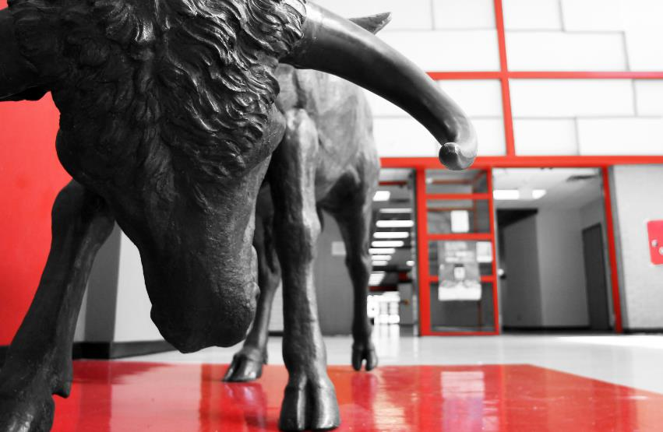
Coaches Education
Bloomingdale High School
New Bull Academy - meet with all my new coaches before students return (summer)
Requesting money/off-season/paperwork
Conflict resolution
BE approachable or they will go above you
Talk about playing time
Pair them with experienced coach (Mentorship)
Meet monthly with AD
Communicate w/ mentors once a week
Coaches Meeting with all coaches at beginning of year
Monthly meetings (In-person or email)
Send emails with County / FHSAA policies (ongoing)

Slide 18
Coaches Education
Bloomingdale High School
Inform coaches of resources
Share articles / then follow-up
Cover FACA Memberships
Pay for hotels / proof of attendance
In-service
Attend practice on weekly basis
Know coach strengths/areas of improvement
End of year Parent Survey and Student Survey
https://goo.gl/forms/ttTtErCRNXhAyYZt1
End of season coaching evaluation
Honest feedback
Assist coach with self reflection
Positives and negatives

Slide 19
Coaches Education
Creating a Coaches Education Program

Slide 20
Coaches Education
Creating a Coaches Education Program

