Slide 1

Mindset Matters
2019
Annual Conference
Developing a Successful Culture Within Your Athletic Department

Slide 2
Culture Matters
What percentage do you think your mindset and the mindset of your coaches plays in the success/failure of your athletic department?

Slide 3
What is Culture in Sports?
A culture is the expression of a team's values, attitudes, and beliefs of who and what they are. It’s the collective behavior of the group.

Slide 4
Mindset Matters
Can you define and describe your culture?

Slide 5

Vision and Values
Successful teams/programs create a vision, values and mission statement.
Who they are
What they believe in
What they do
How they do it

Slide 6
Vision and Values
Is the behavior of the players/coaches modeling the vision and values that you have defined?

Slide 7
Mindset Matters
Culture is invisible. It is made visible by the collective behavior of a department/team.

Slide 8
Culture Matters
Culture is created from the top down
(Administration)
and
Comes to life from the bottom up (Coaches/Players/Parents)

Slide 9
Culture Matters
Culture drives expectations and beliefs.
Expectations and beliefs drives behavior.
Behavior drives habits and habits create your results.

Slide 10
Culture Matters
Culture trumps strategy and execution. It’s what makes a team success sustainable.
Culture determines how you will perform and deal with obstacles.

Slide 11
Culture Consist Of……
Purpose
Attitudes
Values
Goals
Practices/Process
Behaviors/Habits

Slide 12
Effective Leadership
“Leadership is the art of leading others to deliberately (efficacy) create a result that wouldn’t have happened otherwise.”

Slide 13
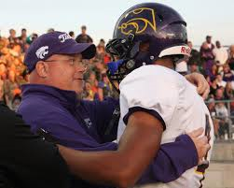
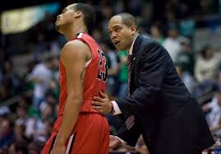
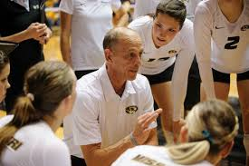
ACCOUNTABILITY
The job of an effective leader is to help people see the relationship between what they are doing and the outcome they expect.

Slide 14
Culture Matters
When a team/organization has a defined culture that is understood and accepted by all of its members, they feel an implicit pressure to support that culture.

Slide 15
How to Develop Culture
Develop Naturally by individual team members
Develop through intentional process of the Athletic Director

Slide 16
How to Develop Culture
Involve team members
Clearly define expectations and process
Create team leaders to support culture
Provide opportunities to build team culture
Create shared responsibilities
Create team rituals
Schedule weekly feedback sessions

Slide 17
Elements of a Successful Culture
AD’s are deliberate about what they want
AD’s have a specific process
AD’s, Coaches and players define values and behaviors
Effective Leaders model desired behavior
Organizations use words/phrases to describe themselves

Slide 18
Elements of a Successful Culture
AD’s give Coaches appropriate ownership over departments direction.
Behavior both poor and good is recognized immediately
Recurring bad behavior is not tolerated
Performance standards and effort are never compromised
Department culture is easily recognized and defined by outsiders

Slide 19
Culture Matters
Culture
of
Communication

Slide 20
Culture through Communication
“Confusion leads to misunderstanding, and misunderstanding leads to conflict. You can prevent a load of trouble by making sure your meanings and actions are clearly understood.”
Joe Torre, NY Yankees

Slide 21
Culture through Communication
Open and Direct Communication
  Know your Role: Individual Meetings
  Open Door/Close Door Policy

Slide 22
Culture through Communication
Conflict and Confrontation
  Approach Person and Situation with Respect
  Use it to get everyone on the same page instead of a means to make examples of people.

Slide 23
Culture through Communication
Encourage the “Why?”
  Good teaching when the “why” accompanies the “what.”
  Use it as a positive sign that they want to learn and perform.

Slide 24
Culture through Communication
Take a Proactive Approach
  See the signs
  Timing is everything
  Take the time to know your coaches and have a sense of how to deal with them

Slide 25
Culture through Communication
It’s Not Just What You Say
  90% of message is translated through body language
  Work at making non-verbal communication align with verbal communication

Slide 26
Culture Matters
Culture
of
Caring

Slide 27
Culture of Caring
Relationships are the foundation upon which winning teams are built.
Relationships are built on values, respect, love, trust and care.

Slide 28
Culture of Caring
Caring is a Strategy

Slide 29
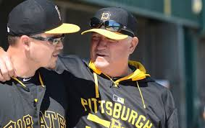
Culture of Caring

Slide 30
Culture of Caring
Care about the work you do
Surround yourself with people who care
Show your department you care about them
Build a team that cares about each other
Show your school community you care about them

Slide 31
Culture of Caring
Be a leader who cares: text messages, notes, listen, encouragement, go out of way, serve
Sacrifice for coaches
You all care, but life gets in the way sometimes.
Be present when you are with your staff
Take interest in their lives

Slide 32
Culture of Caring
It’s not about you saying you care, but its about what your team will say about how much you care.

Slide 33
Culture of Caring
Do your coaches think you are doing everything you can to maximize their abilities not only as coach but more importantly as a person?

Slide 34
Culture of Caring
Be consistent with your caring…Shouldn’t matter on ability level or sport that they coach.
Your job as an AD is to make sure your coaches know you care about them
See them more than just a staff member

Slide 35
3M’s
Model: Exemplify behaviors with integrity
Mentor: Repetition of behaviors
Monitor: Hold coaches accountable for behavior and provide feedback

Slide 36

Culture of Caring
Caring is contagious!
It creates consistency in effort.

Slide 37
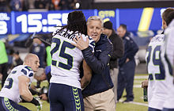

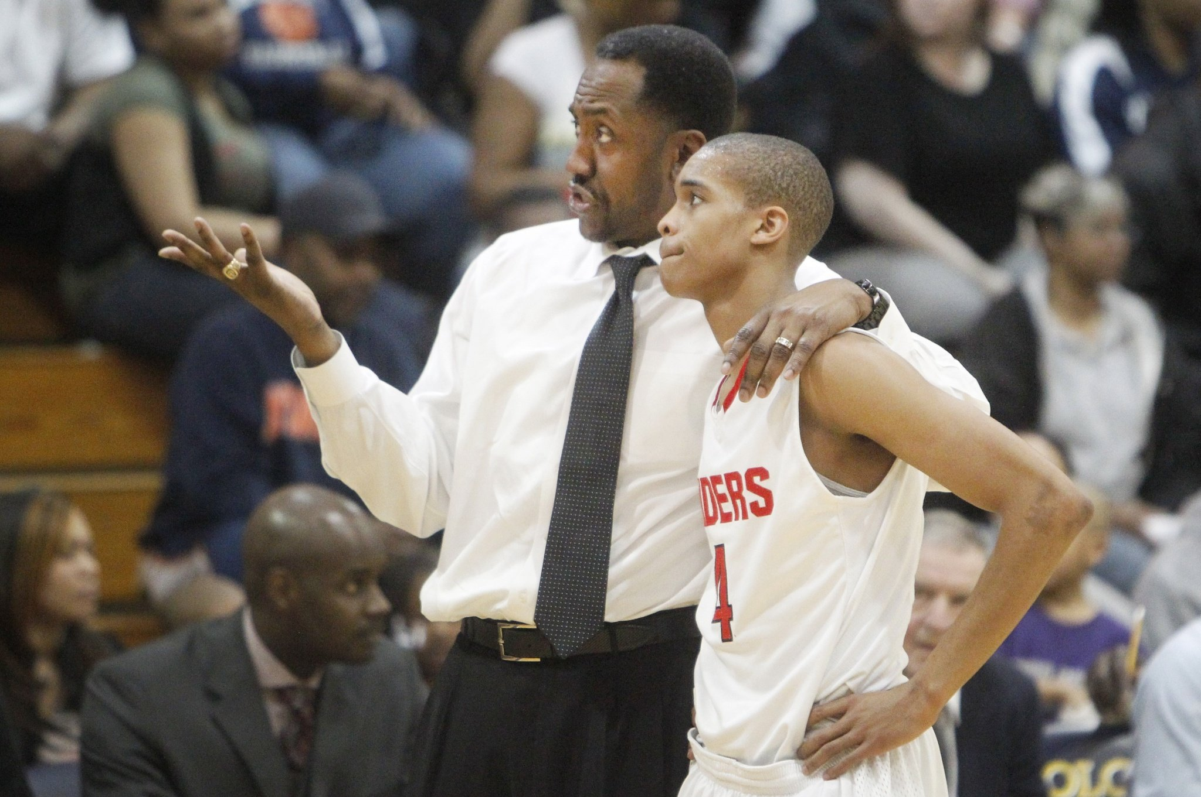
What is your caring trademark?

Slide 38
Elements of a Successful Culture
Athletic programs won’t have success just because of a good culture, but they definitely won’t have success without it!

Slide 39
7 C’s of Championship Culture
Common Goal
Commitment
Complementary Roles
Clear Communication
Constructive Conflict
Cohesion
Credible Leadership
Notes:
39
Flip charts or table discussion (Facilitators, use your own discretion.). Have each table report.
Facilitators could ask the group: Where am I functioning below my potential? What is good enough for me?

Slide 40
7 C’s of Championship Culture
Common Goal
  Clear Vision
  Trust the Process
  Must be a unified effort to accomplish
  Exp…Develop effective process, standards and habits, Conference Championship, 3.0 Team GPA….
Notes:
40
Flip charts or table discussion (Facilitators, use your own discretion.). Have each table report.
Facilitators could ask the group: Where am I functioning below my potential? What is good enough for me?

Slide 41
7 C’s of Championship Culture
Commitment
  Continual Commitment to programs common goal is essential to success.
  Championship programs buy in to mission and make it their own.
  Creates personal and group accountability.
Notes:
41
Flip charts or table discussion (Facilitators, use your own discretion.). Have each table report.
Facilitators could ask the group: Where am I functioning below my potential? What is good enough for me?

Slide 42
7 C’s of Championship Culture
Complementary Roles
  Championship programs have coaches that know and accept their roles.
  “Greater Good” mentality
  No role/team is more important than any other role even though it may get more attention.
Notes:
42
Flip charts or table discussion (Facilitators, use your own discretion.). Have each table report.
Facilitators could ask the group: Where am I functioning below my potential? What is good enough for me?

Slide 43
7 C’s of Championship Team Culture
Clear Communication
  Open and Honest communication is mandatory for success
  Communicate frequently
  Know the “pulse” of the program
Notes:
43
Flip charts or table discussion (Facilitators, use your own discretion.). Have each table report.
Facilitators could ask the group: Where am I functioning below my potential? What is good enough for me?

Slide 44
7 C’s of Championship Culture
Constructive Conflict
  Effectively deal with conflict
  Address it in a timely manner
  Never make it personal
Notes:
44
Flip charts or table discussion (Facilitators, use your own discretion.). Have each table report.
Facilitators could ask the group: Where am I functioning below my potential? What is good enough for me?

Slide 45
7 C’s of Championship Culture
Cohesion
  Players genuinely like and respect each other
  Championship teams spend social time together
Notes:
45
Flip charts or table discussion (Facilitators, use your own discretion.). Have each table report.
Facilitators could ask the group: Where am I functioning below my potential? What is good enough for me?

Slide 46
7 C’s of Championship Culture
Credible Leadership
  The leaders must be respected and credible in what they do.
  They must demonstrate the skills and characteristics to lead and do it on a consistent basis.
  3 M’s: Model, Mentor, Monitor
Notes:
46
Flip charts or table discussion (Facilitators, use your own discretion.). Have each table report.
Facilitators could ask the group: Where am I functioning below my potential? What is good enough for me?

Slide 47

FIAAA Annual Conference
Paul Herfurth
954-288-3272
ph483@nova.edu

